Slide 1
Negative sampling, Attention mechanism, 1D convolution and pre-trained feature extraction

Slide 2
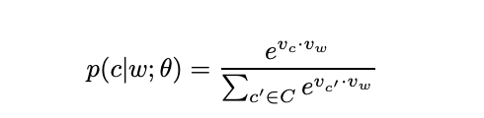
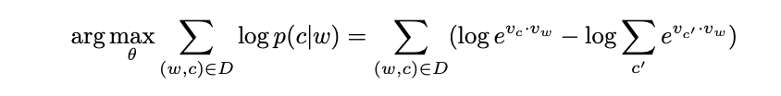
Negative sampling for Word2Vec
Parameterization of the skipgram model
We want to maximize this log-likelihood
EXPENSIVE COMPUTATION!!!!

Slide 3
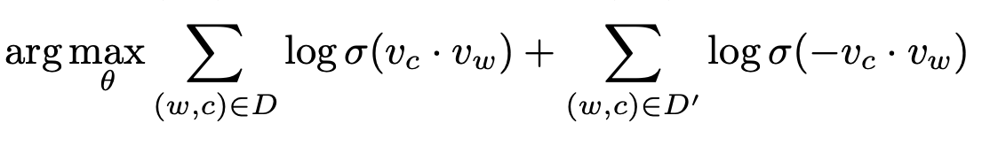
Negative sampling for Word2Vec
Instead of considering all the words in the vocabulary, consider a few “negative samples” for each “positive sample”. Typically, we consider 5 negative samples. Randomly sample 5 negative (false) contexts for each positive (correct) (word, context) in the dataset. In the equation below, D’ is the set of word and context which are invalid i.e., (w,c) ∈ D’ means w never appears in the context c indicates the (w,c) ∈ D’ is the set of all negative examples. The size of this set is much smaller than the original vocabulary size.

Slide 4
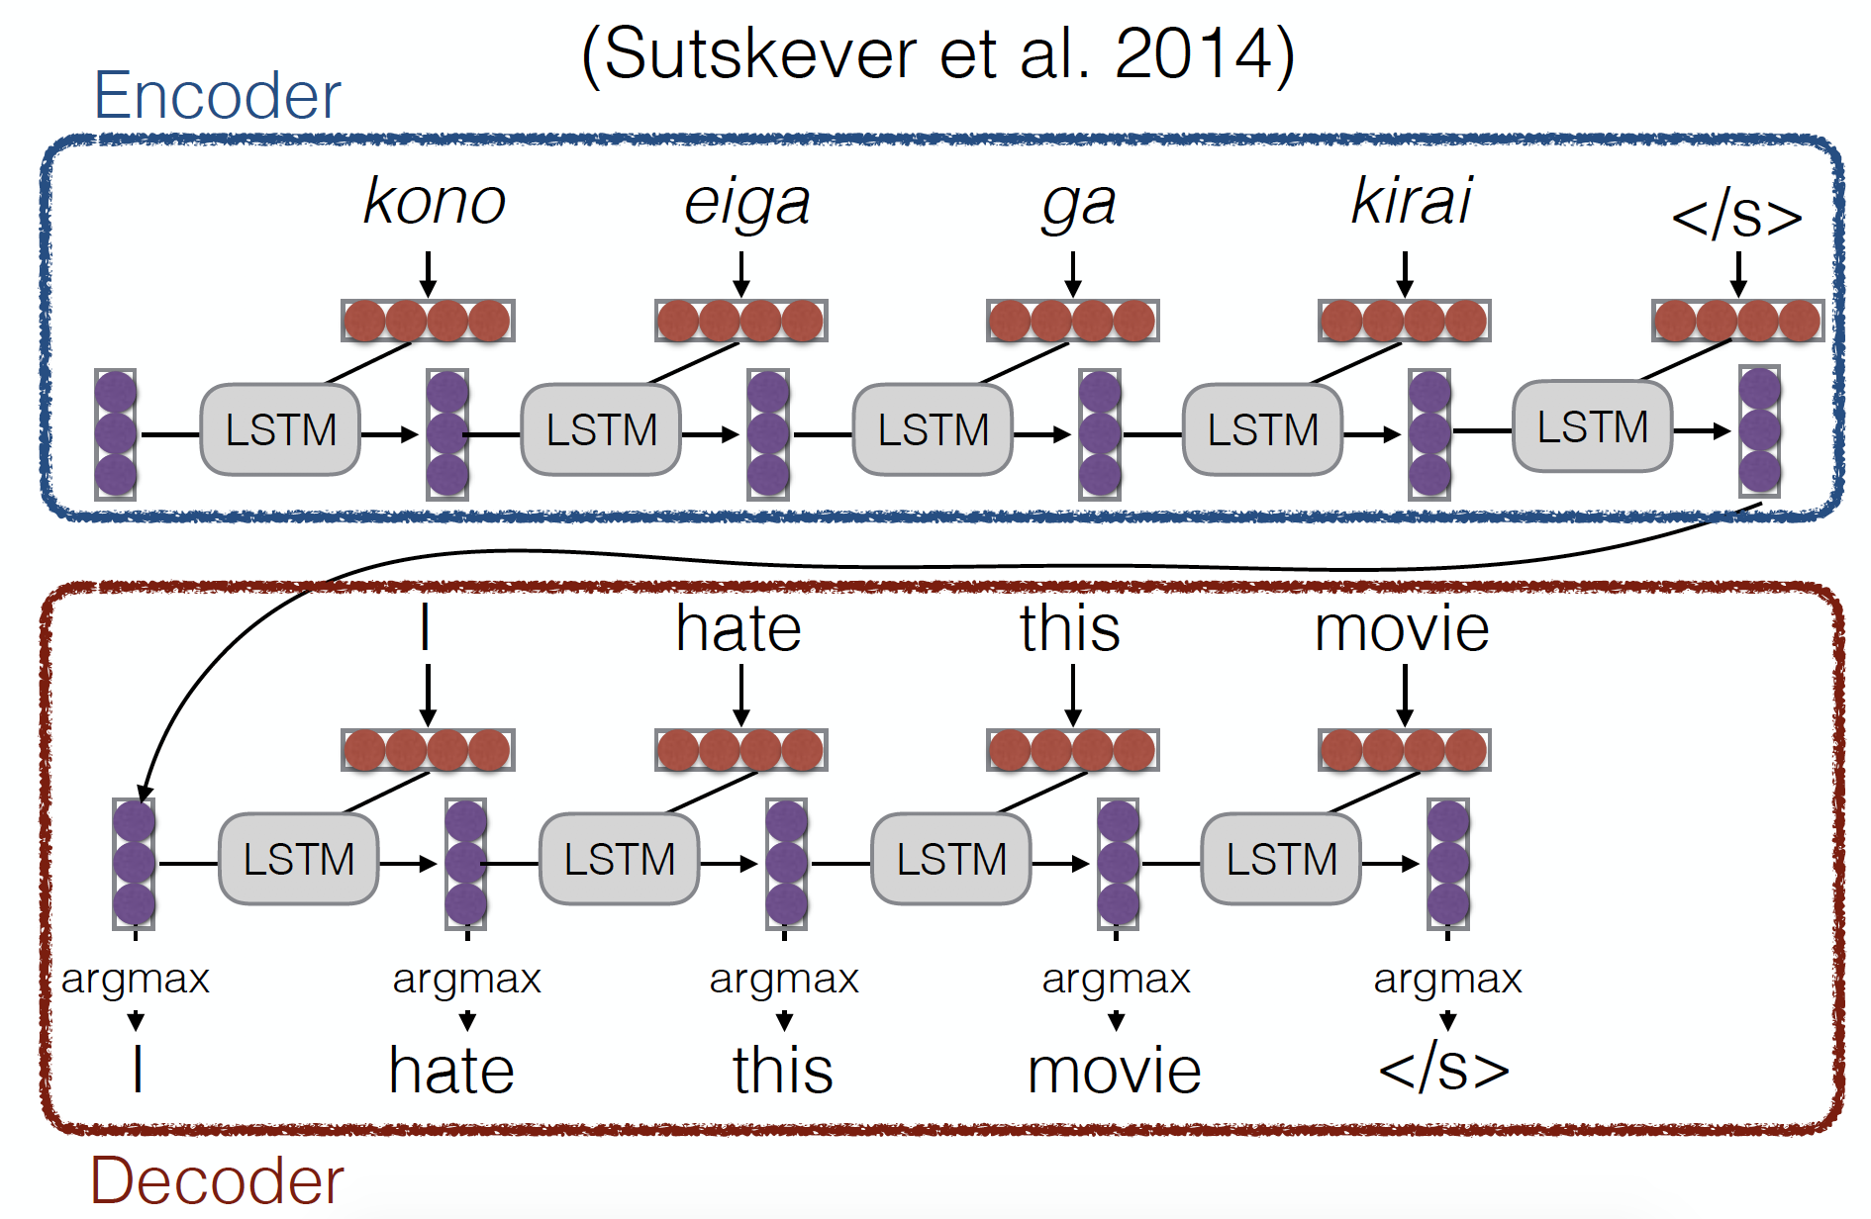
Encoder-decoder Models

Slide 5


Sentence Representations
Problem!
“You can’t cram the meaning of a whole %&!$ing sentence into a single $&!*ing vector!”
— Ray Mooney
•
But what if we could use multiple vectors, based on the length of the sentence.
this is an example
this is an example

Slide 6
Attention

Slide 7
Why attention?
•
Look into distant features
•
Combine all the features in the sequence to produce a better feature representation

Slide 8
Basic Idea
(Bahdanau et al. 2015)
•
Encode each word in the sentence into a vector
•
When decoding, perform a linear combination of these vectors, weighted by “attention weights”
•
Use this combination in picking the next word

Slide 9




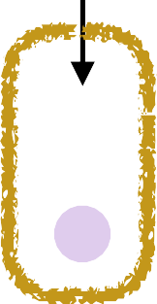

Calculating Attention (1)
Use “query” vector (decoder state) and “key” vectors (all encoder states)
For each query-key pair, calculate weight
Normalize to add to one using softmax
kono eiga ga kirai
Key Vectors
I hate
a1=2.1 a2=-0.1 a3=0.3 a4=-1.0
Query Vector
softmax
α1=0.76 α2=0.08 α3=0.13 α4=0.03

Slide 10

Calculating Attention (2)
Combine together value vectors (usually encoder states, like key vectors) by taking the weighted sum
kono eiga ga kirai
Value Vectors
* * *
α1=0.76 α2=0.08 α3=0.13
*
α4=0.03
•
Use this in any part of the model you like

Slide 11
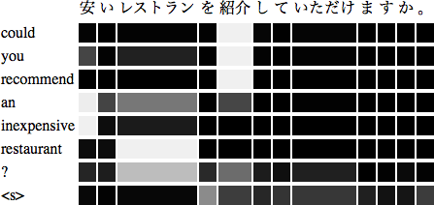
A Graphical Example

Slide 12
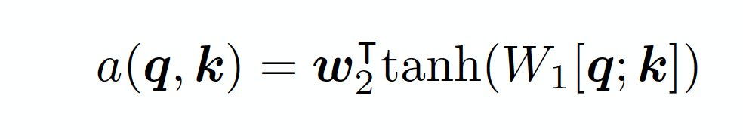

Attention Score Functions (1)
q is the query and k is the key
Multi-layer Perceptron (Bahdanau et al. 2015)
Flexible, often very good with large data
Bilinear (Luong et al. 2015)
•

Slide 13
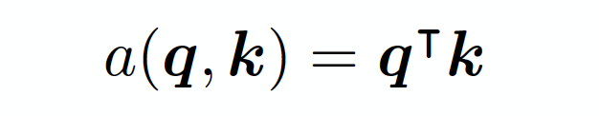
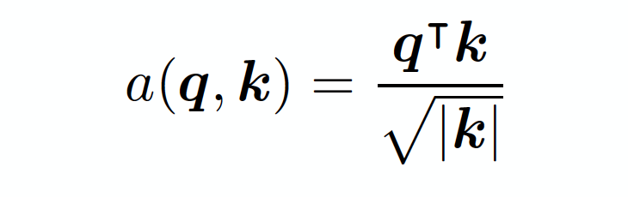
Attention Score Functions (2)
Dot Product (Luong et al. 2015)
No parameters! But requires sizes to be the same.
Scaled Dot Product (Vaswani et al. 2017)
Problem: scale of dot product increases as dimensions get larger
Fix: scale by size of the vector
•
•

Slide 14
Convolutional neural network for text classification
The task: Given a textual training data, train a CNN for classification/regression.
Do you find any similarity with the CNN applied on images?

Slide 15
Convolutional neural network for text classification
Convert text to sequences

Slide 16
Convolutional neural network for text classification
Use word embeddings

Slide 17
Convolutional neural network for text classification
Convolutional kernels

Slide 18
Convolutional neural network for text classification
Convolution over Word Sequences
Example – convolution over Bigrams.

Slide 19
Convolutional neural network for text classification
Convolution over Word Sequences
Example – convolution over trigrams.

Slide 20
Convolutional neural network for text classification
Maxpool

Slide 21
Convolutional neural network for text classification
The overall network

Slide 22
Convolutional neural network as N-gram feature extractor

Slide 23
CNN on images vs text

Slide 24
Pre-trained feature extraction
Suppose we want to solve a task A and we have a dataset D = {T_{i}, L_{i}} where T_{i} is the independent variable and L_{i} is the dependent variable i.e., label. We can train a supervised classifier on this dataset and use this network as a feature extractor for another task B. Note that task A and B are related but not the same task. How can we do it?

Slide 25
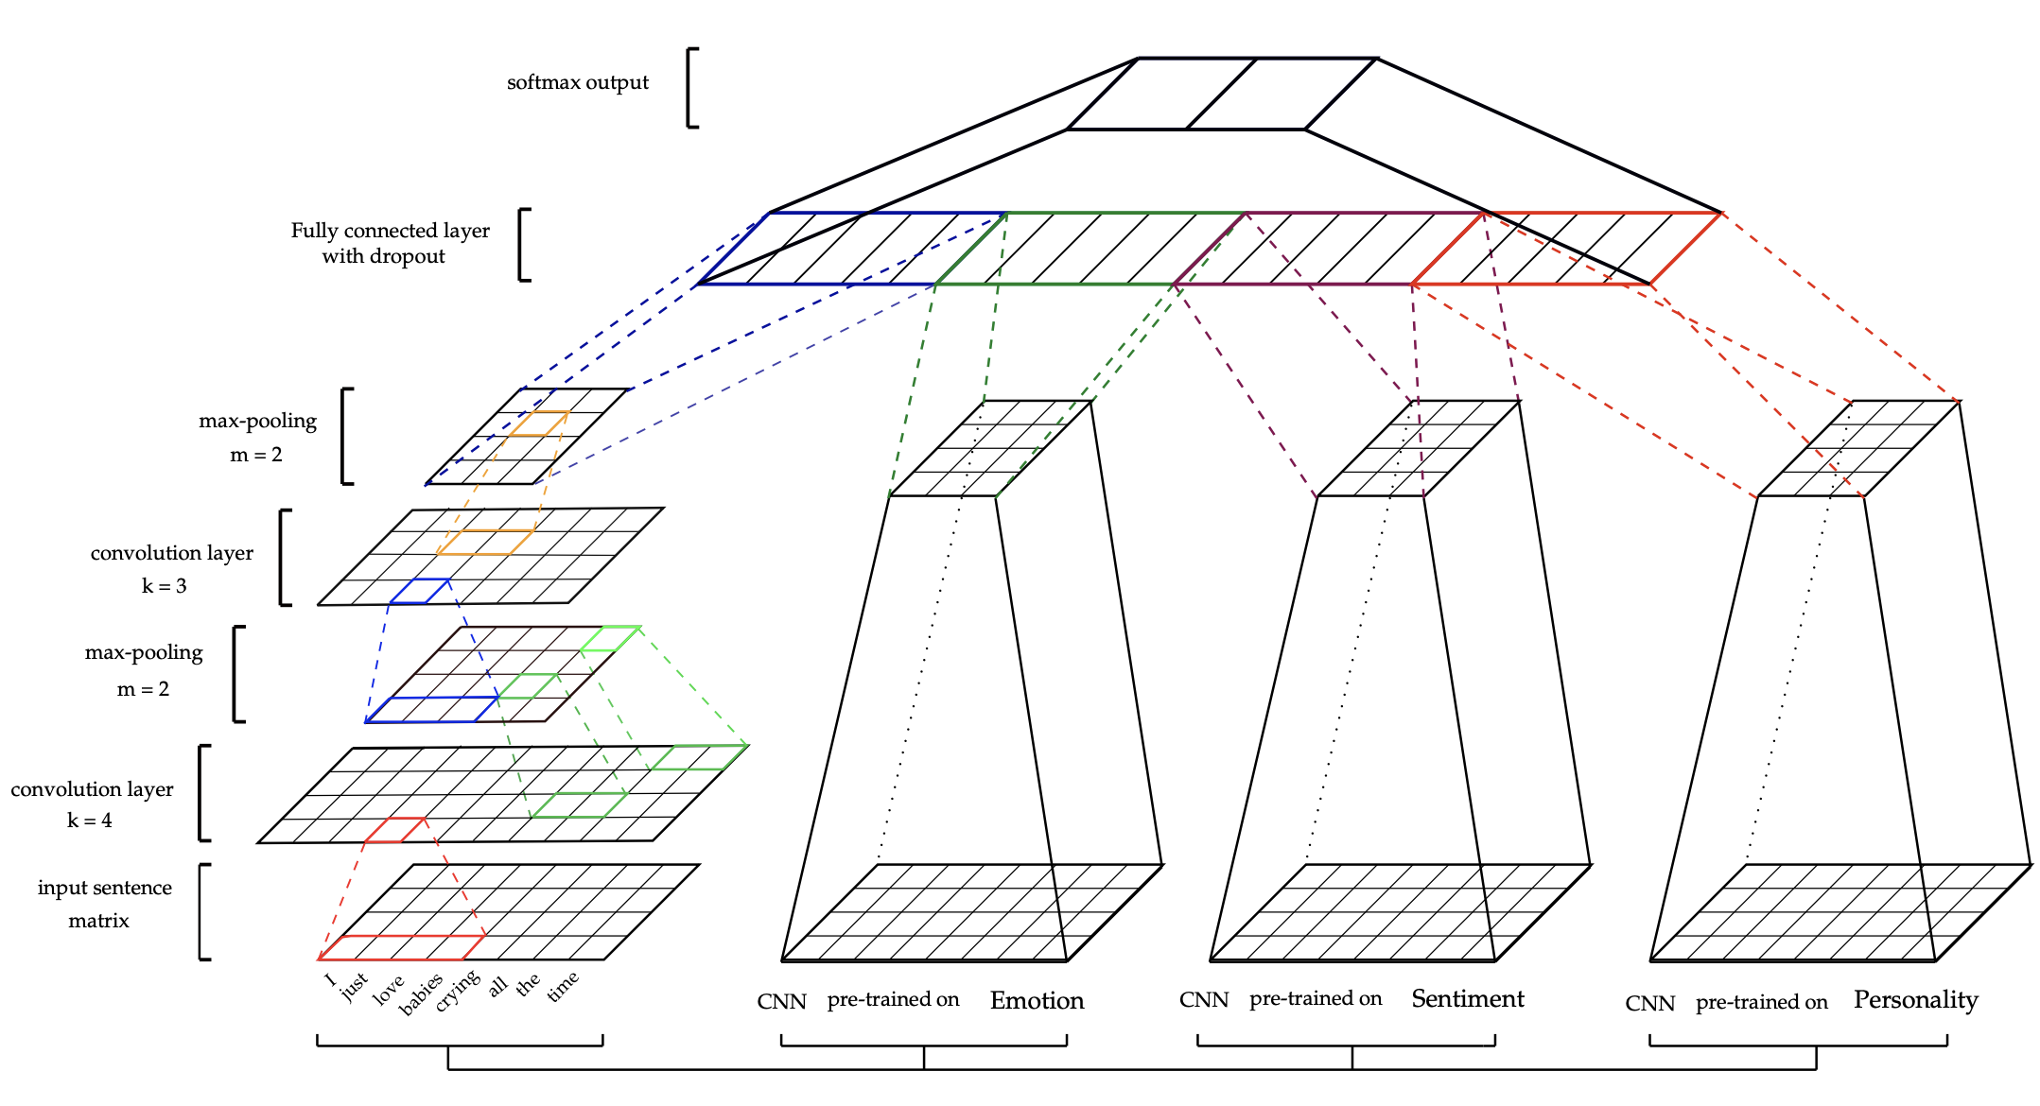
Pre-trained feature extraction
Consider the task of sarcasm extraction.

Slide 26
A sample question
Does the dimension of the LSTM weights depend on the sequence length?
Yes, sometimes.
Yes, always.
No.
LSTM is not a sequential network, hence this question is not valid.

Slide 27
And here is another
Softmax can be used in
Binary classification.
Multiclass classification.
None of 1 and 2.
Both 1 and 2 are valid.

Slide 28
Ah! One more
The output of sigmoid activation is in the range of
[2,4].
[-1,1].
[0,1].
[-1,0].

